Slide 1


SAP UI5 & FIORI with OData TRAINING using BAS
Anubhav Oberoy
Day – 5

Slide 2

Agenda – Day 5
Types of Data Binding Syntax
Types of Binding
Hook Methods of Controller
Modularization of model
Binding Modes.
Concept of Named Model
How to create Named Model
Expression Binding
Aggregation Binding
Changing the default Model at run time
Element Binding
Event Object concept
What is Resource Model.
Steps to create a Resource Model.

Slide 3
Different Methods to Bind Property in View
Binding using the path of the data
{/empStr/empId}
Binding as property specific method:
this.getView().byId(‘controlId’).bindValue(‘/empStr/empSalary’)
Binding as property generic method:
this.getView().byId(‘controlId’).bindProperty(‘value’ , ‘/empStr/empSalary’ )
Binding using the path expression , this is also know as complex binding syntax
{path : ‘/empStr/empId’}
this syntax is helpful when we use formatter .
this syntax will not work by default until we inform it to the SAPUI5, to make this syntax work we have to add a line
code inside the bootstrap code of the application.
data-sap-ui-bindingSyntax= “complex”
Name of the property with which we want to bind

Slide 4
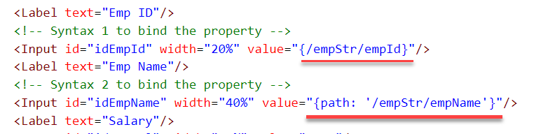
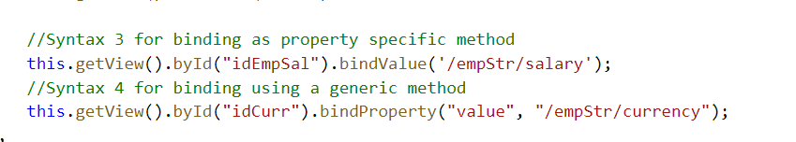
Hands – on: Binding Syntax
Now we will see the different syntax of binding the properties in the View.
Along with that we will see how to align the label and fields in the SimpleForm control.
Code Links:-
MyXML.view.xml
Main.controller.js
Index.html

Slide 5

Types of Binding
SAP UI5 have 4 types of Binding options:
Property Binding
Expression Binding
Aggregation Binding
Element Binding
Property Binding:-
When we bind property of a UI control, to the address/path of the model, this is called property binding. E.g., value property of Input control was connected to /emp/empId
All the four syntaxes we studied in previous slide are the example of property binding.
Ex:-
In XML view:-
<Text text=“{/emp/empId}” ></Text>
In controller: -
this.getView().byId(“controlId”).bindProperty(“text”, ‘/emp/empId’);

Slide 6
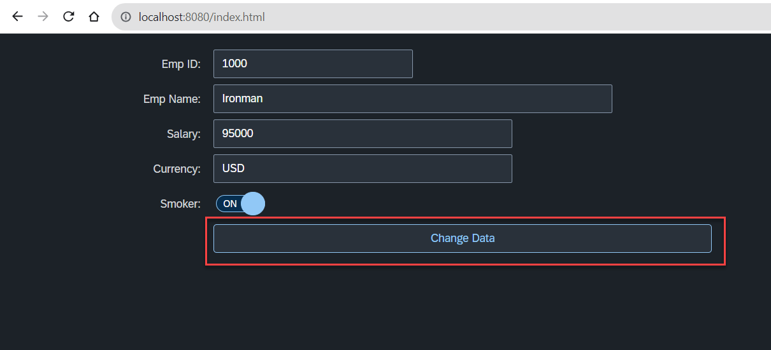
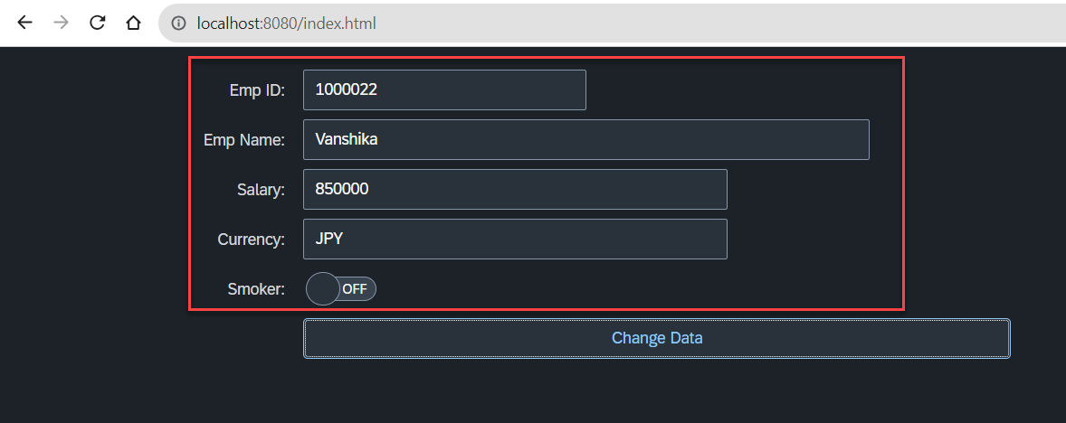
Hands – on: Changing data using Model
Now we will change the form data using the setProperty and getProperty functions.
Initially we used these functions to set the data directly now we will use the Model to change the data.
This process will be done on click of the Change Data button.
Code Links:-
MyXML.view.xml
Main.controller.js

Slide 7
Hook Method of Controller
onInit()
onBeforeRendering()
It is a function which gets called immediately after UI5 creates the object of our controller. It is like constructure of a class. We can use this to initialize our class variable
It is a method which gets called MULTIPLE times, Before every time the view is displayed to the user. We can use this method for pre-processing on a view.
IN
BR
EX
AR
onExit()
onAfterRendering()
It is a function which gets called before the instance of our controller gets destroyed. It is like destructor of a class.
We can use this to write clean-up code.
It is a method which gets called MULTIPLE times, After every time the view is displayed to the user. This method can be used to show effects to the user.

Slide 8
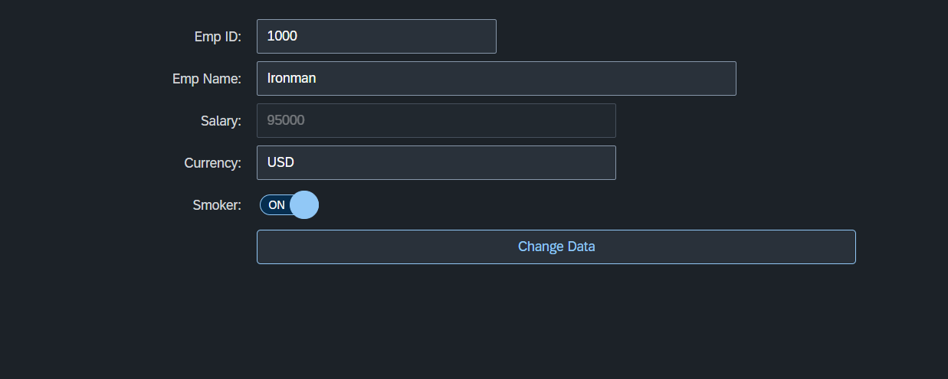
Hands – on: Hook Methods and Global Variable
Now we will see how to create a global variable and use it.
We will also see the use of Hook Methods of a controller.
Code Links:-
MyXML.view.xml
Main.controller.js

Slide 9
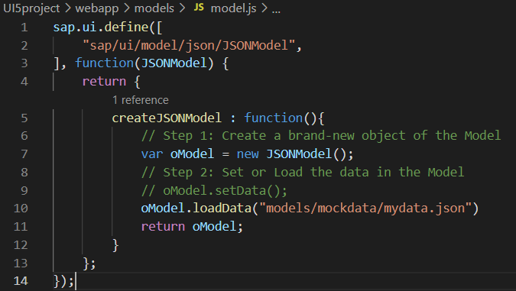
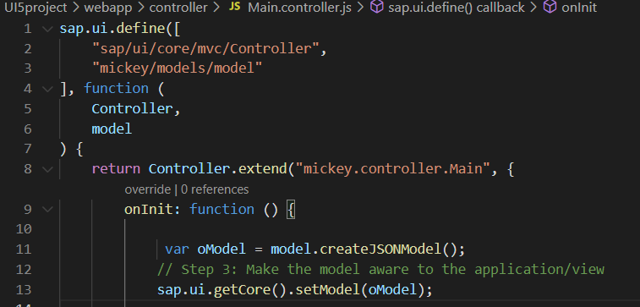
Modularization of Model
1. Create a folder in webapp with name models.
2. Inside models create a file name model.js and then create the function named createJSONModel: function(){}
3. Now create a folder inside the models named mockdata and then inside mockdata create a file named mydata.json
4. Inside the mydata.json put all the data in JSON format.
5. Then inside the models.js :-
6. Then call the model.js inside the controller and create the object then by using the object call the function of model.js
Loading the data from mydata.json using loadData() function
Call the model.js into the controller as dependency.
Object of the model.js
Call the createJSONModel function using the object

Slide 10
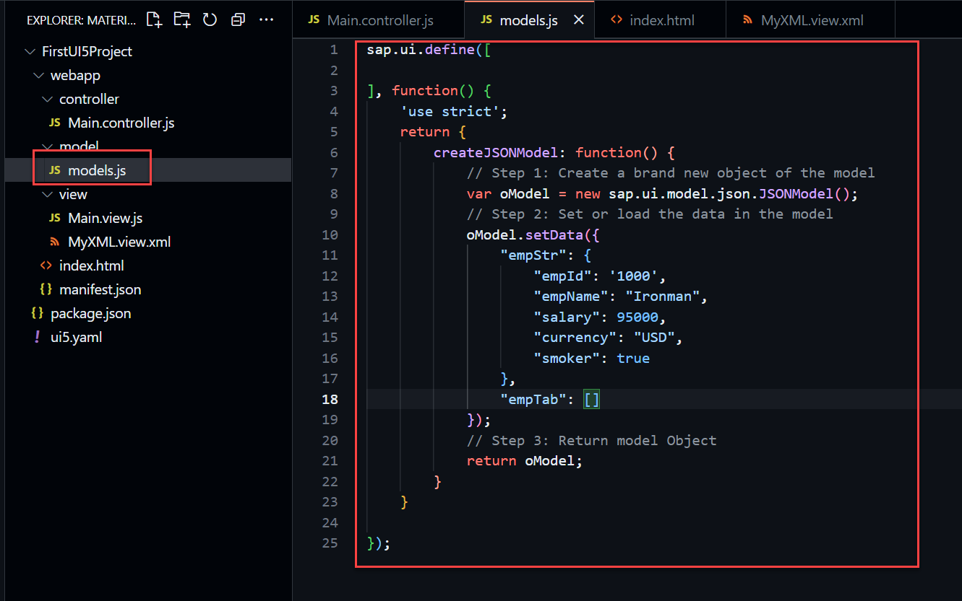
Hands – on: Modularize the Code
Now modularize our model code using the steps shown in the previous slide.
We will also see how to load the data form the model.
Code Links:-
Main.controller.js
models.js

Slide 11
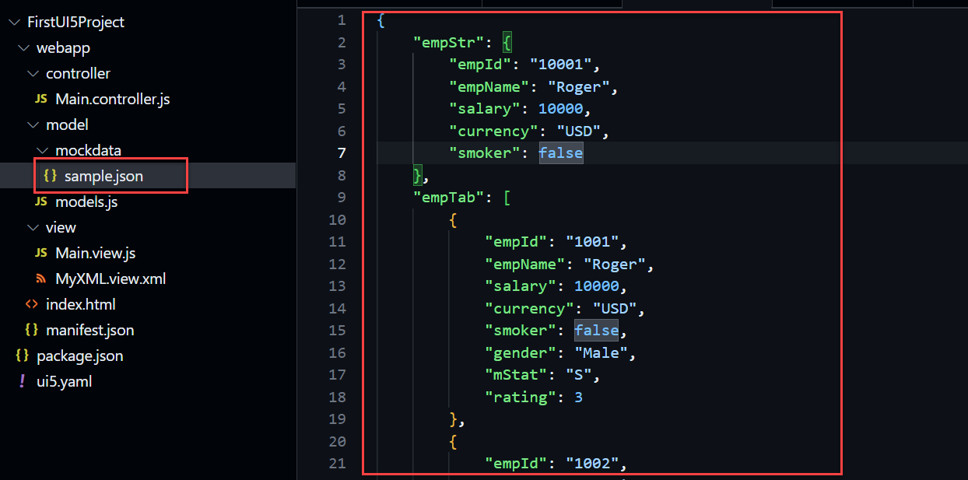
Hands – on: Loading data from file
Till now we have loaded the data in the model from the json structure only.
Now we will load the data into the model from a file.
There will be now change in the output but now the data will be loaded from the sample.json file
Code Links
sample.json
models.json

Slide 12
Binding Modes
There are basically three modes of binding data in SAPUI5.
One-way binding – Here, the data is transported in one direction only, i.e., from the model, through the binding instance to the consumer (usually the property of a control), but never in the other direction. Any change done on the model data from the front end is not affected to the model. All the data changes are reflected only on the controls.
Two-way binding – Here all input changes done from front end controls are reflected on the model and the backend database. SAPUI5 automatically handles the transport of data both from the model to the controls and back from the controls to the model. It is the default binding mode.
One-time binding – Here all data will be bound from model to view just once. After that, the connection is no more set.
Data
Data
Model
View
Model
View
Data
One-way binding
Two-way binding
Data
Data
Data
Model
View
Model
View
One-Time binding

Slide 13
Concept of Named Model
Concept of named model comes into observation when we want to use more than one model simultaneously in one application. When we uses two model simultaneously the there are some conflicts arises in the application , as the second model we use will overwrite the data of the first model. So, here we use the Named Model
Creation of Named Model :
this.getView().setModel(oModel2 , “Name of the model”) ;
For example :
this.getView().setModel(oModel2 , “thanos”); → here thanos is the name of the model
Binding using the Named Model:
So in binding we use this name, to bind the data from the named model we use modelName>path in binding syntax
For example:
“{thanos>/empStr/empName}” this will bind the name from thanos model.

Slide 14
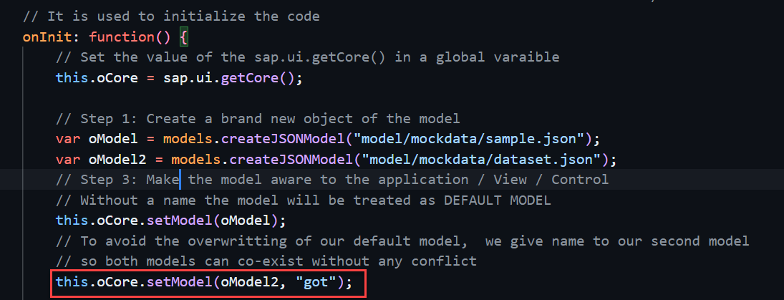
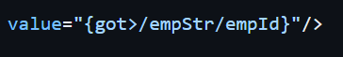
How to create a Named Model
Create a model (dataset.json) in the models folder .
In controller , we have to give the path in the createJSONModel() function
In model.js we have to pass the path as a parameter to create the model with different paths form the same function.
To bind the data in view , we have to use the name of the named model.

Slide 15
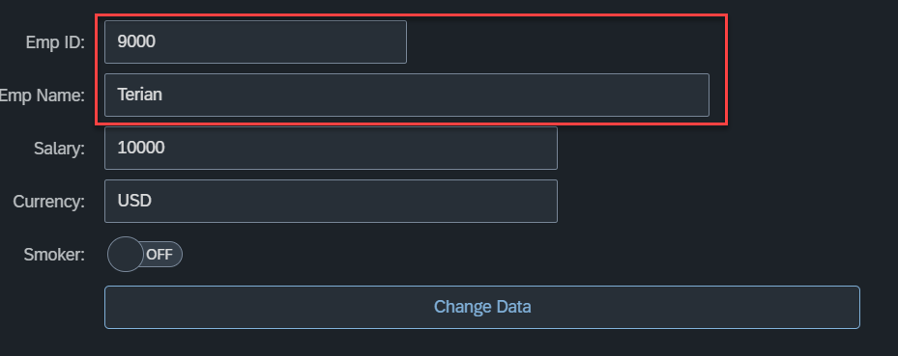
Hands – on: Named Model Creation
Till now we have loaded the data in the model from the json structure only.
Now we will load the data into the model from a file.
There will be now change in the output but now the data will be loaded from the sample.json file
Code Links
dataset.json
models.json
Main.controller.js
MyXML.view.xml

Slide 16
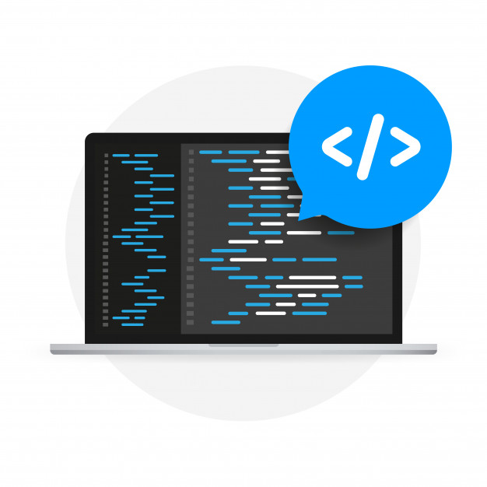
Expression Binding
Expression binding : - When we bind an Expression ({= condition ? true : false}) with the property of a control rather binding value to a property, this is called expression binding.
If we need some calculation on model data or some sort of comparison, then expression binding is useful.
Syntax:
numberState = “{= ${path} > value ? ‘conditionForTrue’ : ‘ConditionForFalse’ }”
Use Case of Expression Binding
My Manager want to add a make salary field grayed(read-only) whenever the employee name is Anubhav.
If The Employee Name is Anubhav, the salary must be 20000.
Condition – if employee name = Anubhav
Outcome – the salary must be 20000
Target – Salary field

Slide 17
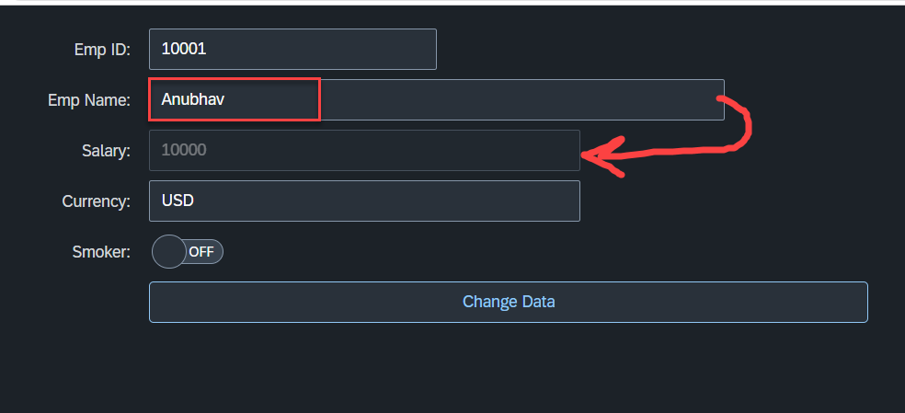
Hands – on: Expression Binding
Now we will bind the Salary field in the SimpleForm with the help of Expression binding Syntax according to the use case mentioned in the previous slide.
Before that we have to comment the line in the controller in which we are binding it form model.
Code Link:-
MyXML.view.xml
models.js

Slide 18
Aggregation Binding with Table Control
When we bind the aggregation of a control with the entityset of data model, it is called aggregation Binding.
The parent control (e.g. Table) is bound to the EntitySet path which is called absolute path and the child of the parent Control (e.g. Columns) are connected to the child properties of the EntitySet is called relative path.
In aggregation binding, based on your model data, as many child controls will be created automatically.
Every Event of UI5 will trigger the eventHandler and we will get the Event Object as part of the event Handler. Depending on the event, the event handler object will have different parameters.
Use Case of Aggregation Binding
If we want to show a list or some data in tabular format, we need to bind a group of data. In such a case we will use aggregation binding.
Absolute path
{
“empTab”: [
{
“empId”: 50,
“empName”: “Jay”,
“salary”: 9500
}
]
}
Table = {/empTab}
Emp Id | Emp Name | Salary
{empId} | {empName} | {salary}
Relative Paths

Slide 19
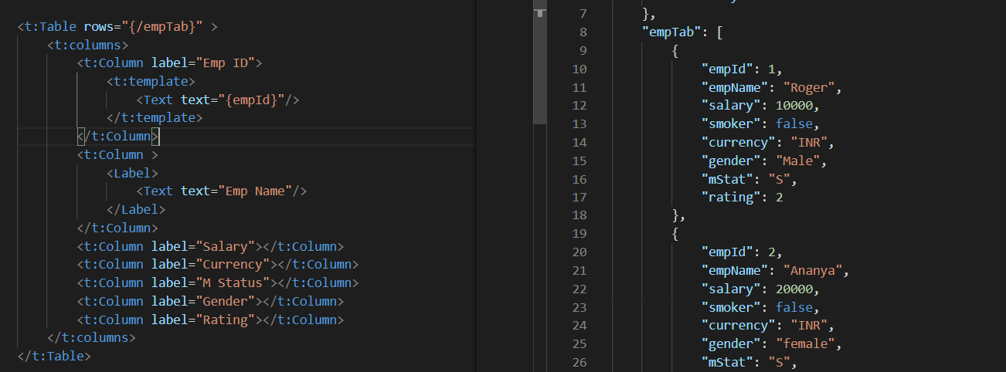
Absolute Path : Connecting parent to parent
Relative Path : connecting child to child respective to parent control

Slide 20
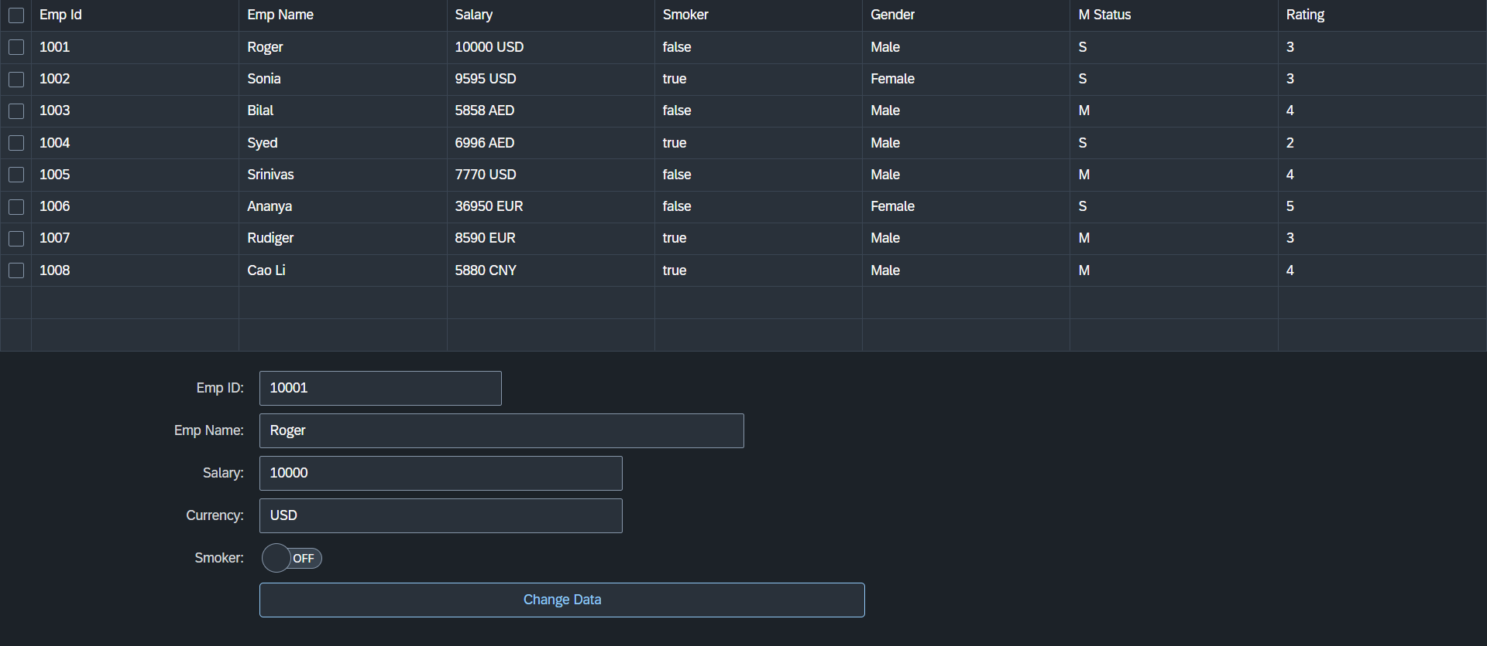
Hands – on: Aggregation Binding & Table
Now we will see how the Aggregation binding works with the help of the table control in SAP UI5.
Documentation of Table control:- https://sapui5.hana.ondemand.com/#/api/sap.ui.table.Table
Code Link:
Main.view.xml

Slide 21
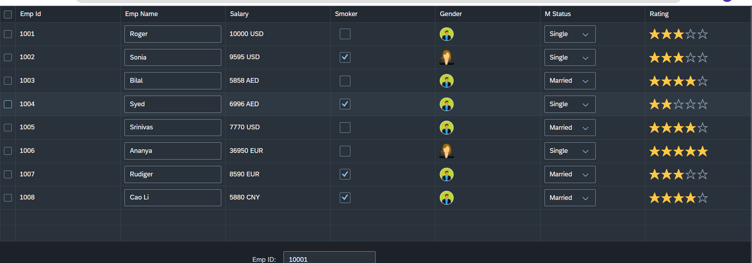
Hands – on: Table with Different Controls
Now we will add different type of controls to the UI table, like Input field, Image, Select, Rating Indicator, Check Box etc.
Code Links:-
MyXML.view.xml
sample.json

Slide 22
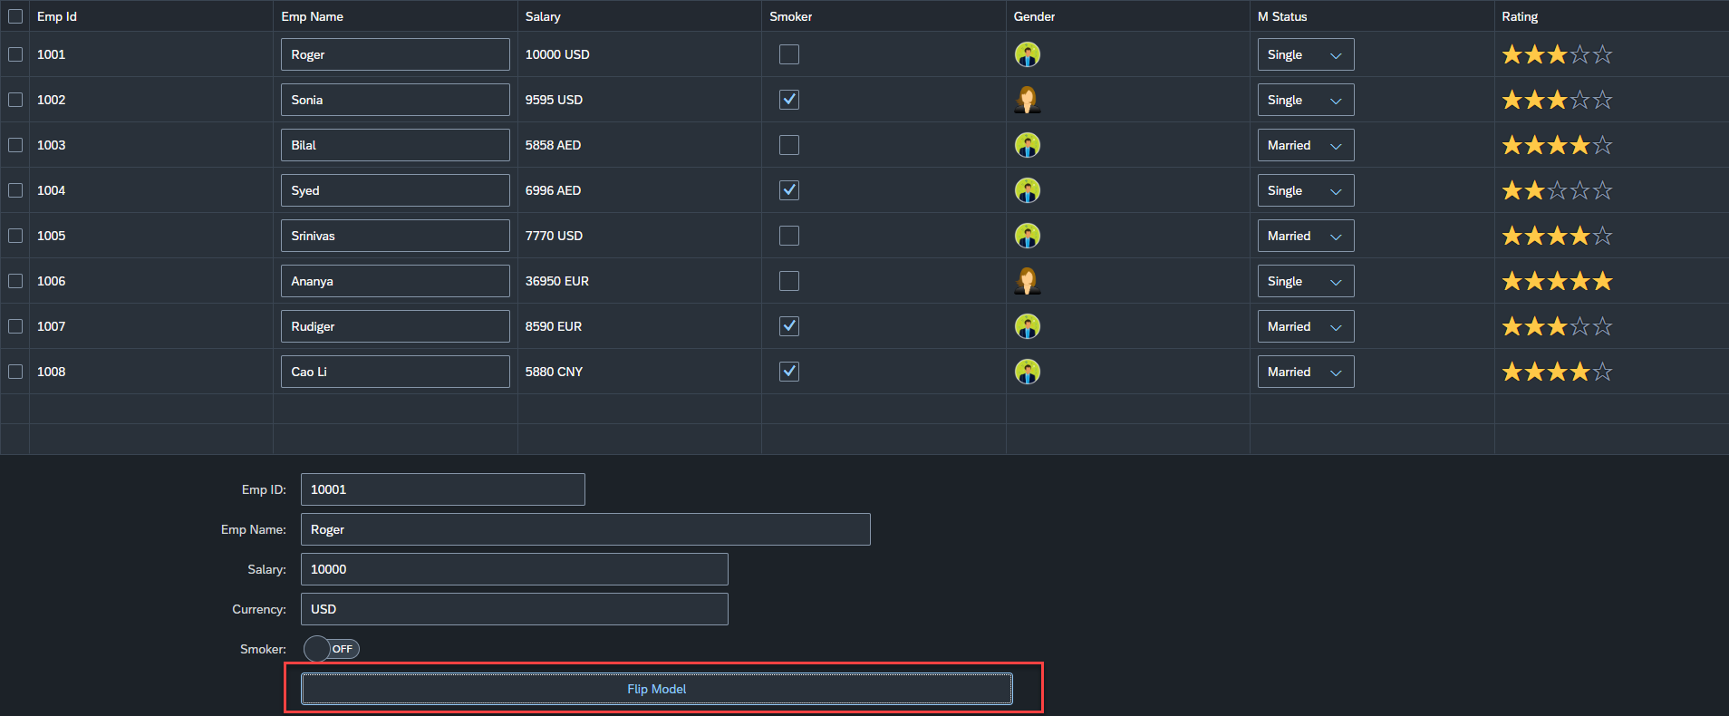
Hands – on: Flipping the default Model
Now we will change the default model in in the application on press of a button in the ui.
For this we will create a Flip button on the ui the default model bind to the application will be changed every time. (Flip Flop).
Along with that we will set the Visible number of rows in the Table to 5.
Code Links:-
Main.controller.js
MyXML.view.xml

Slide 23
Element Binding
To Understand the element binding first we have to understand about the what is element.
Element : Data related to the table inside the model memory is called as element ,
so, if we have 10 elements in the model we will get eventually 10 rows in table at runtime.
“empTab": {
"empId": 1,
"empName": "Roger",
"salary": 10000,
"smoker": false,
"currency": "INR",
"mStat": "S",
"rating": 2
}, ,
{
"empId": 2,
"empName": "Ananya",
"salary": 20000,
"smoker": true,
"currency": "INR",
"mStat": "S",
"rating": 4
}
Id | Name | Salary
1 | Roger | 10000
2 | Ananya | 20000
Element 0
Element 1

Slide 24
Element Binding continues..
Element binding is useful for containers and layouts containing other controls. All these child controls would be required to use properties of the same model object or model node, then element-binding is preferable.
An element to be bound to an object in the Model can be achieved by Element binding.
Use case:- On Select of a row in the table show the row data in a form.
The path of the element will always be the :
/entitysetname/index of the element
Table
Emp Id | Emp Name | Salary
{empId} | {empName} | {salary}
Element 0
/empTab/0
/empTab/1
/empTab/2
Element 1
Element 2
Simple Form
Field 0
/empId
All the content of Row 1 in the table is bind to all the fields in the form
Field 1
/empName
Field 2
/salary

Slide 25
Event Object Concept
Every UI5 event handler method will be entitled to receive an object free in the function, this object is know as event object.
This object is responsible to carry important information about the event.
For example : the rowSelectionChange event’s event object will let you know about the index of the row selected by the user.
Every Event object in SAPUI5 have exact 3 same function which are generic :
getSource() : will give the object of the source control from where event was originally generated. We can get object of the control, we can use it without giving an id.
getParameters() : every event carries a lot of the information about the user action e.g. row index of the selected row of the table. All this info come in form of parameters.
getParameter() : if we want to get single parameter value we can get it using this getParameter() function.
Note : best practice to use event object is put oEvent in the function’s parameter and using a hard debugger and then check the information got by the event object in browser’s console.

Slide 26
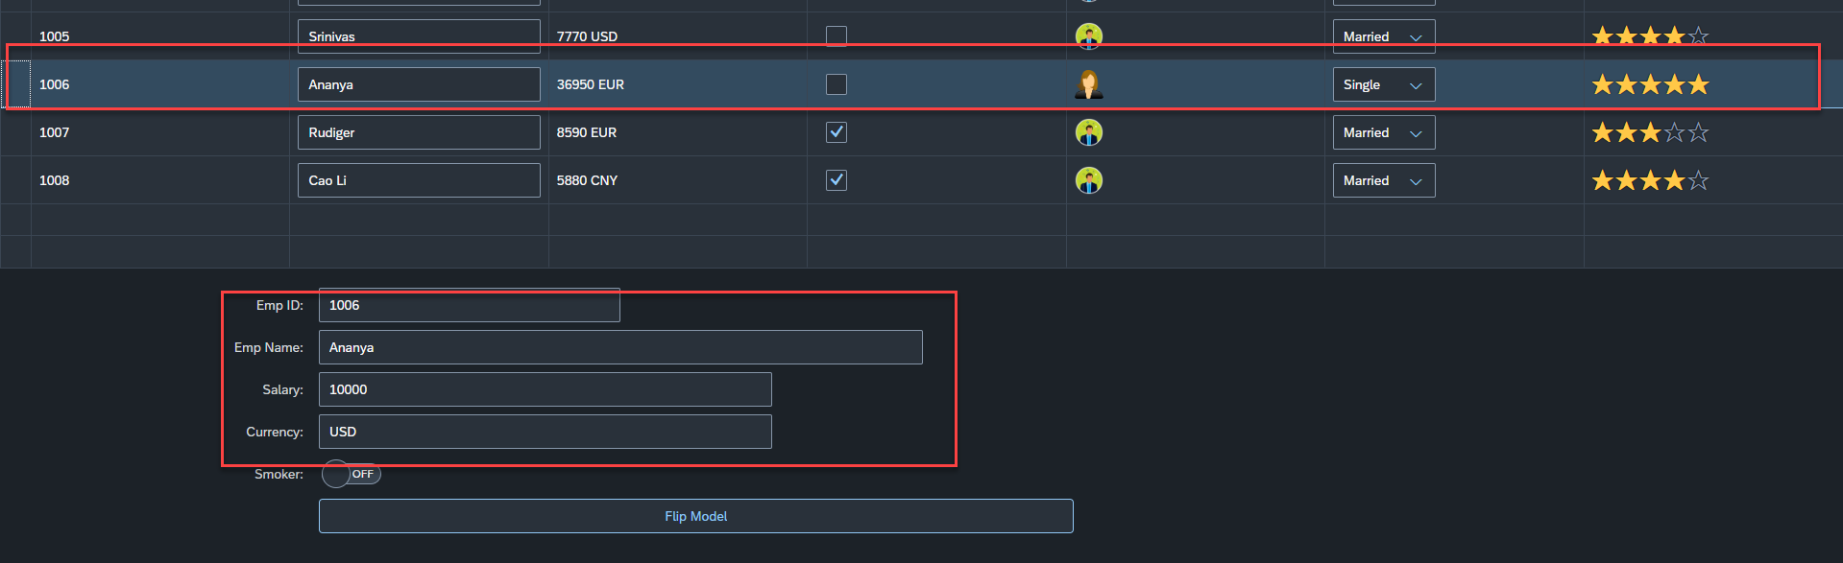
Hands – on: Element Binding
Make the table rows from multiselect to single select.
On select one row the data of that row have to shown in the SimpleForm by using the event object and element binding discussed in the previous slides.
Code Links:-
MyXML.view.xml
Main.controller.js

Slide 27
Resource Model
We build software for international audience, we cannot just hardcode every screen element in English, if it requires multi-lingual support, we need to add resource model.
i18n → Internationalization : Make the app available for international usage, which means supporting multiple languages.
There are 2 job roles in the process:
UI5 Consultant
Language Expert KM
?sap-ui-language=hi
Implement the model to provide support for internationalization
Translate the texts to provide support in multiple languages
I18n.properties
TEXTS
Language specific

Slide 28
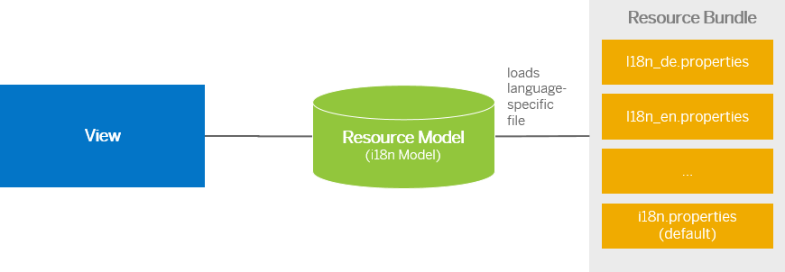
Steps to Create a Resource Model
Create resource bundle which includes label field
Create a folder i18n and inside this folder the file named i18n.properties for default labels.
And i18n_langcode.properties for different languages
Set The model
For more information about i18n you check the link
https://openui5.hana.ondemand.com/1.34.9/docs/guide/831039835e7c4da3a8a0b49567573afe.html
We can change the language of the app by adding ?sap-language=language_code at the end of the URL of the app. Example for Hindi we will write ?sap-language=hi

Slide 29
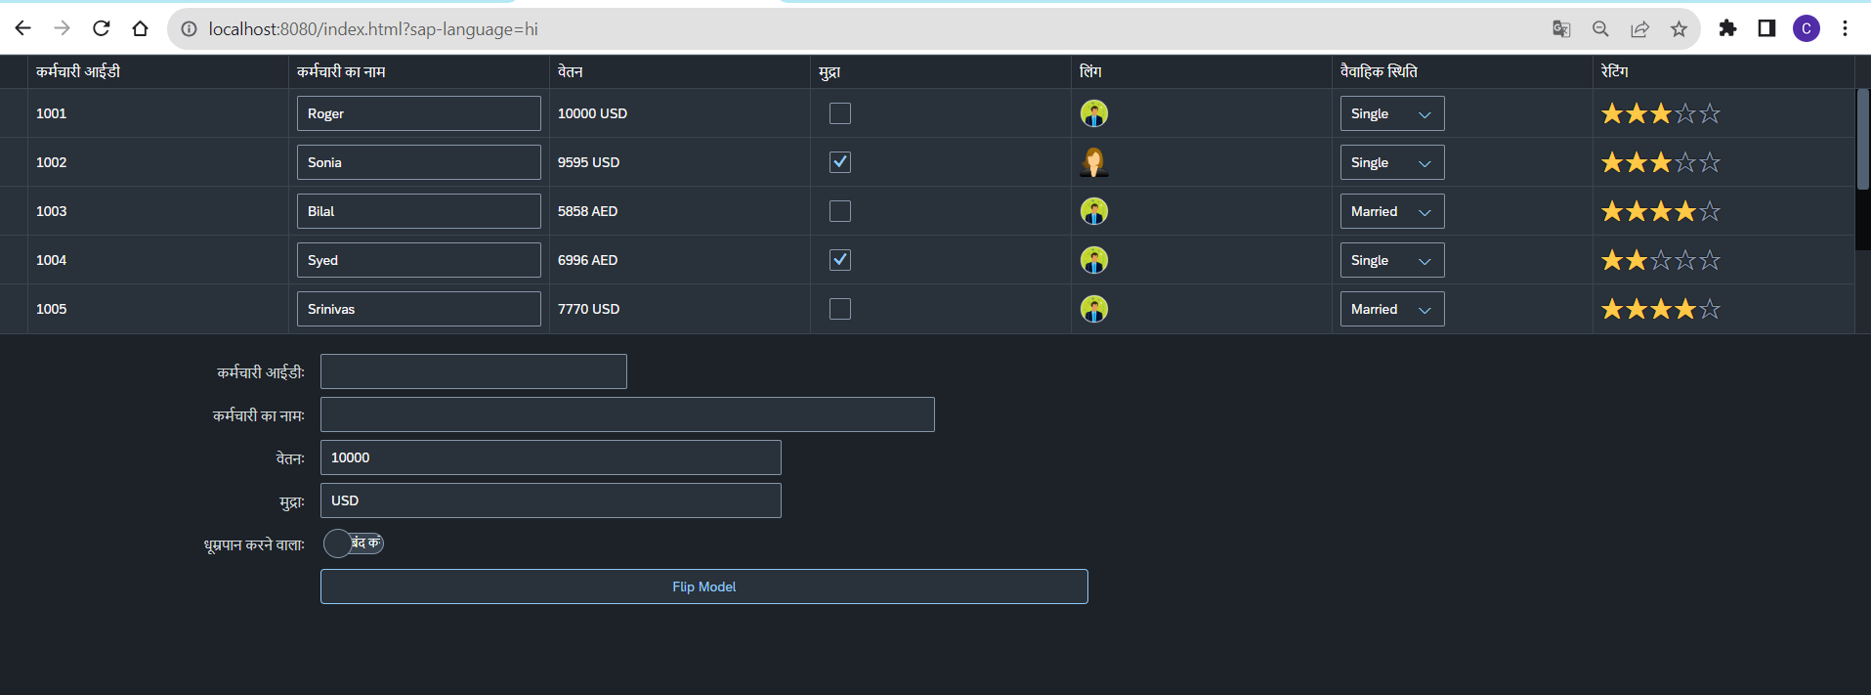
Hands – on: Resource Model
Now we will see how the language of an app is changed using the i18n file.
We have to create a folder ‘i18n’ in webapps folder and in the folder, we have to add files named ‘i18n.properties’ and one another file named according to the language we want. For example:- for Hindi language the file is named as ‘i18n_hi.properties.
Code Links:-
MyXML.view.xml
Main.controller.js
models.js
i18n.properties
i18n_hi.properties

Slide 30

End of Day 5

Slide 31

Questions

Slide 32

Anubhav Oberoy

Slide 33


We’re committed to empower you to be
Most Desirable Resource
through powerful training solutions.
We build the workforce of the future.
250+
Corporate Clients
30,000+
Learners Trained
25000+
Learners Placed
FREE WEBINARS
Sign up for free webinars with industry experts every fortnight!
Enroll Now!
Contact us today!
https://anubhavtrainings.com/

Slide 34




More from AnubhavTrainings.com

Slide 35
Title
Content

